Slide 1


RSA IAM Framework
Faculty of Information Engineering and Technology
Networks Departement
Team 4

Slide 2
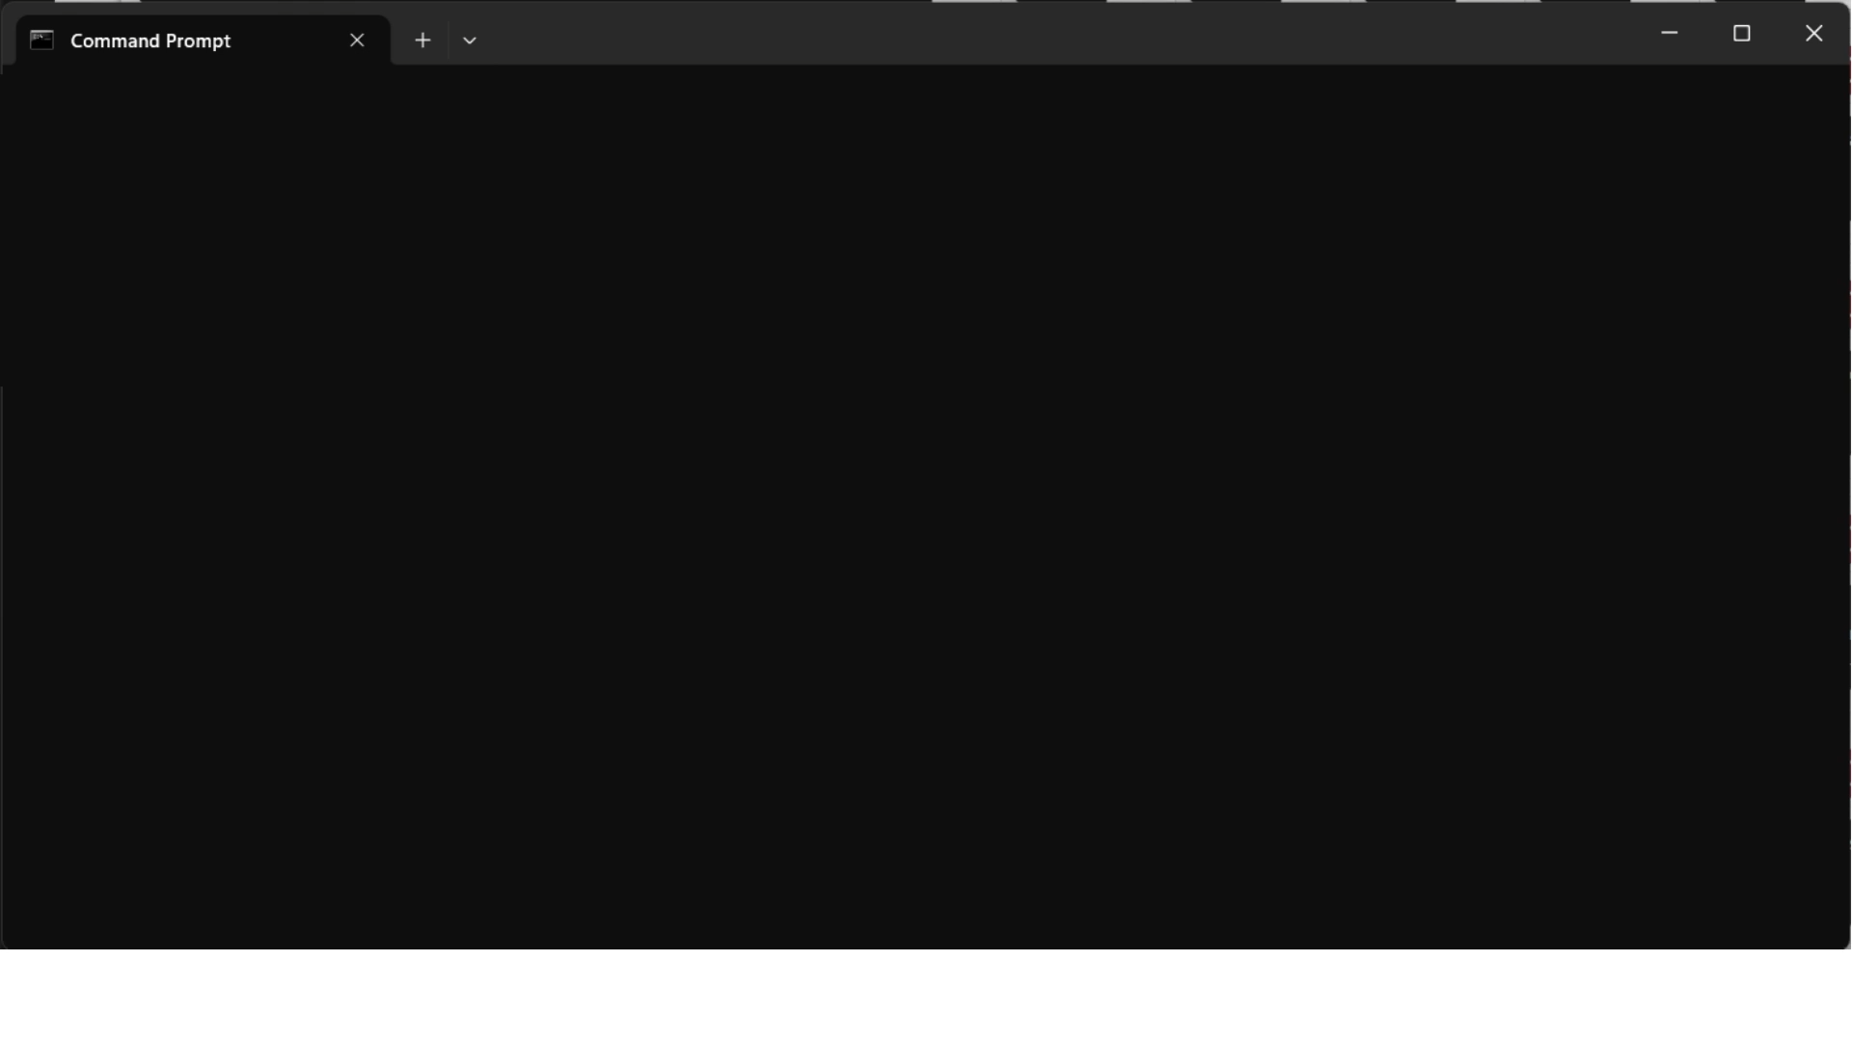
RSA IAM Framework

Slide 3
Outline
1. Foundation Setup
2. Enable MFA
3. App-Level Security
4. Stress Testing
RSA IAM Framework

Slide 4
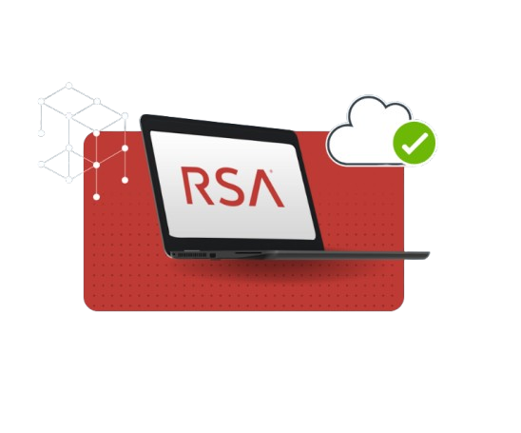
Foundation Setup
RSA IAM Framework

Slide 5
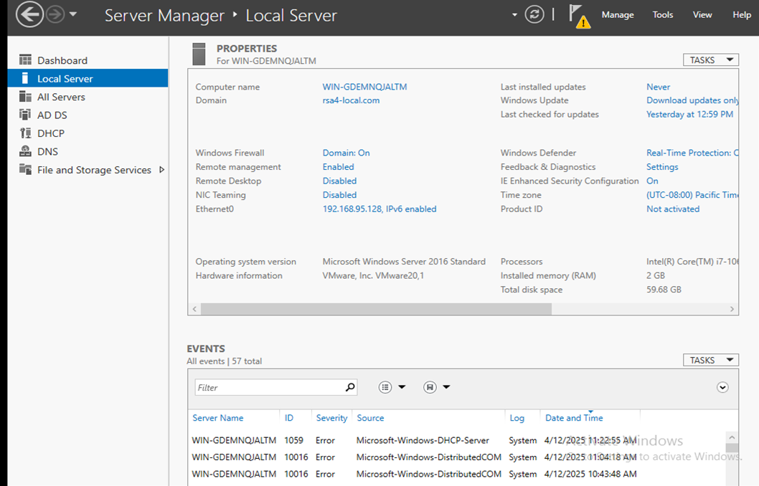
Setting up Domain Controller VM
RSA IAM Framework

Slide 6
Configure Domain Controller - Network Settings
Virtual Machine Function (Domain Controller/MFA Agent/IDR) | Domain Controller
Operating System (Windows/Linux) | Windows
Fully Qualified Domain Name | rsa4-local.com
IP Address | 192.168.95.128
Gateway | 192.168.95.2
DNS | Primary:192.168.95.2 Secondary:8.8.8.8
RSA IAM Framework

Slide 7
Configure IDR - Network Settings
Virtual Machine Function (Domain Controller/MFA Agent/IDR) | IDR
Operating System (Windows/Linux) | Linux
Fully Qualified Domain Name | rsa4-local.com
IP Address | 192.168.95.129
Gateway | 192.168.95.2
DNS | Primary:192.168.95.128 Secondary:8.8.8.8
RSA IAM Framework

Slide 8
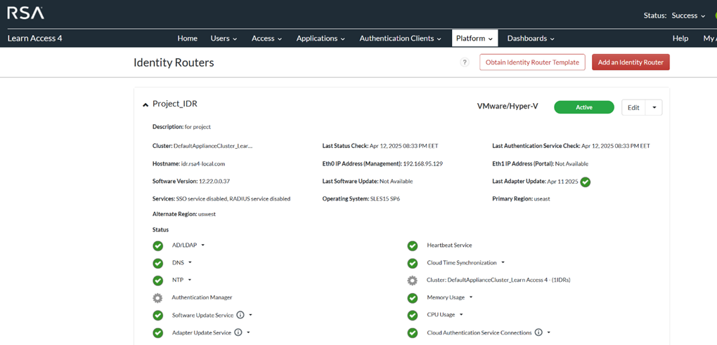
IDR connected to the CAS
RSA IAM Framework

Slide 9
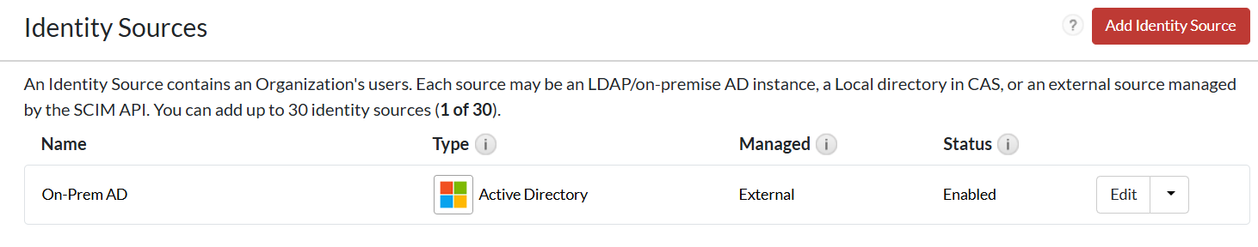
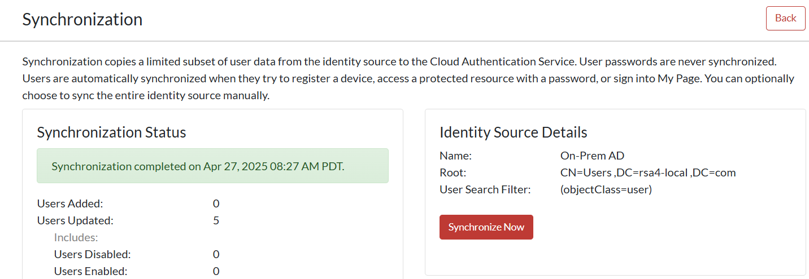
Synchronizing AD with the CAS
RSA IAM Framework

Slide 10
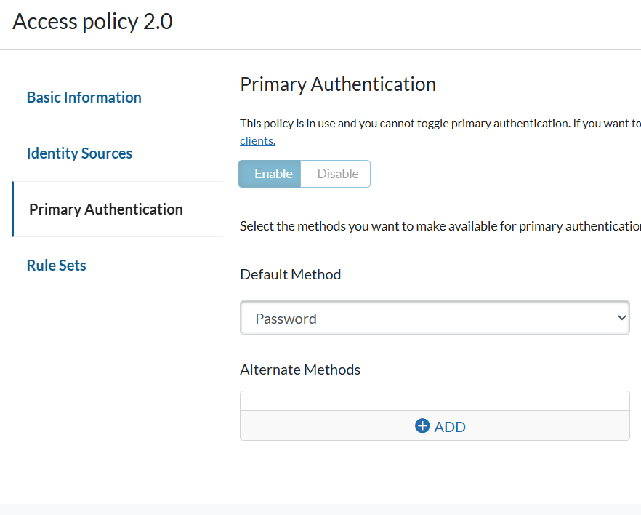
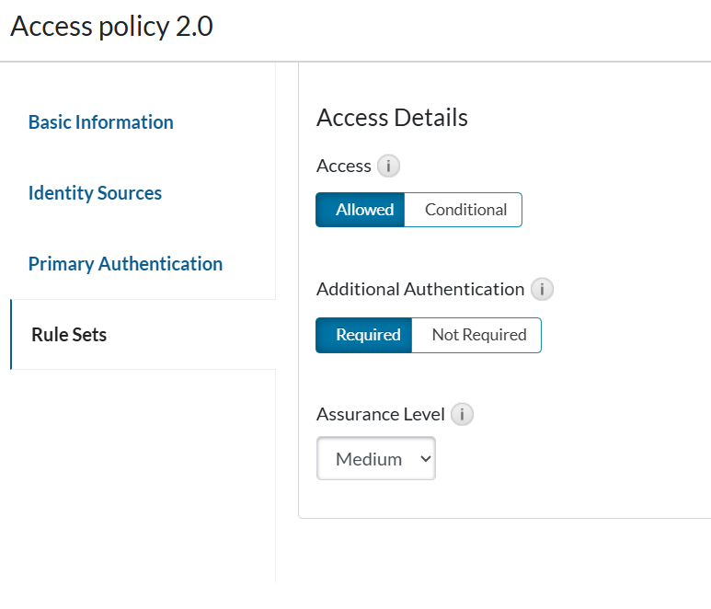
Configuring Access Policy 2.0 for My Page
RSA IAM Framework

Slide 11
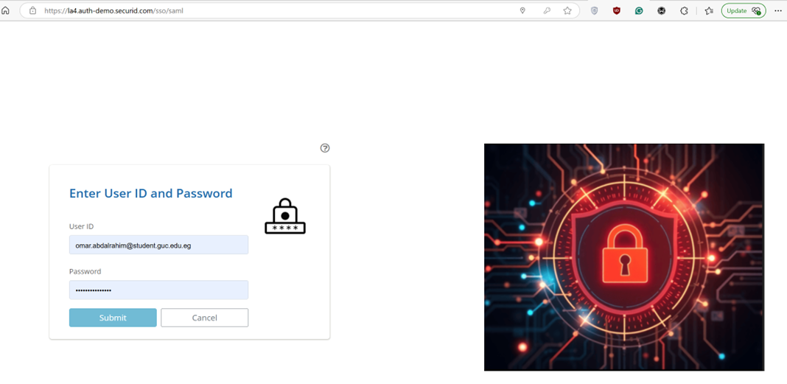
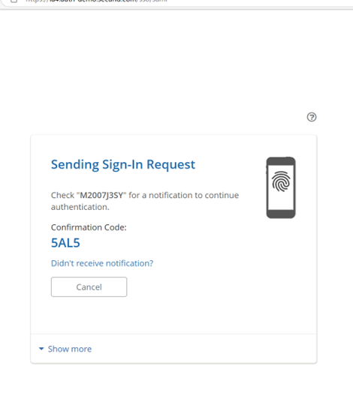
Accessing My Page
RSA IAM Framework

Slide 12

2. Enable MFA
RSA IAM Framework

Slide 13
MFA Implementation Workflow
AD User Group
MFA Policy on CAS
Install MFA Agent
Test MFA Authentication
Configure GPO
RSA IAM Framework

Slide 14
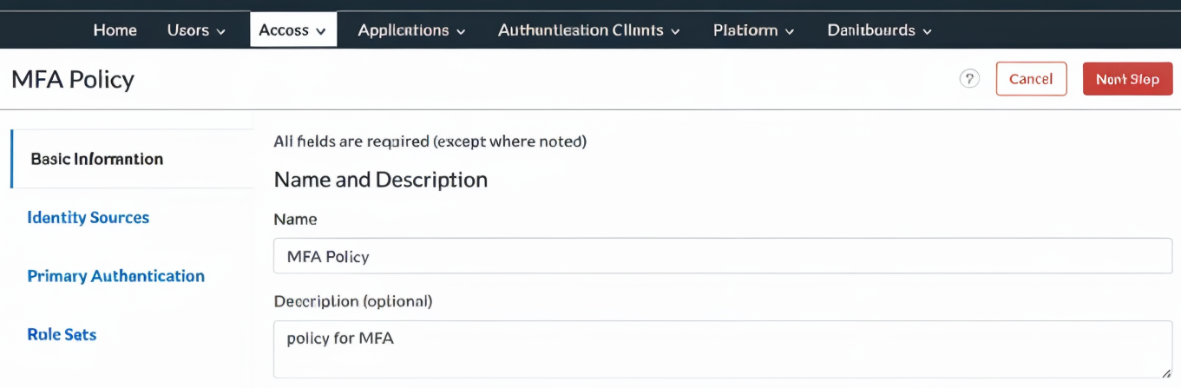
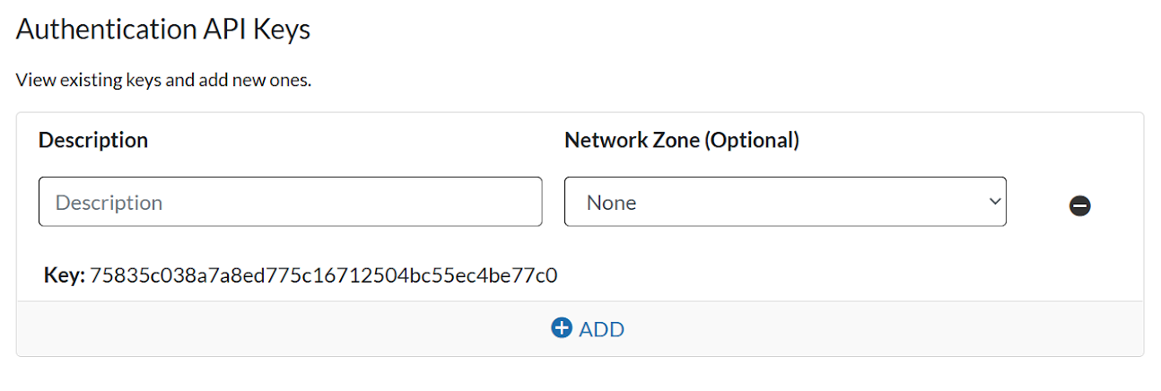
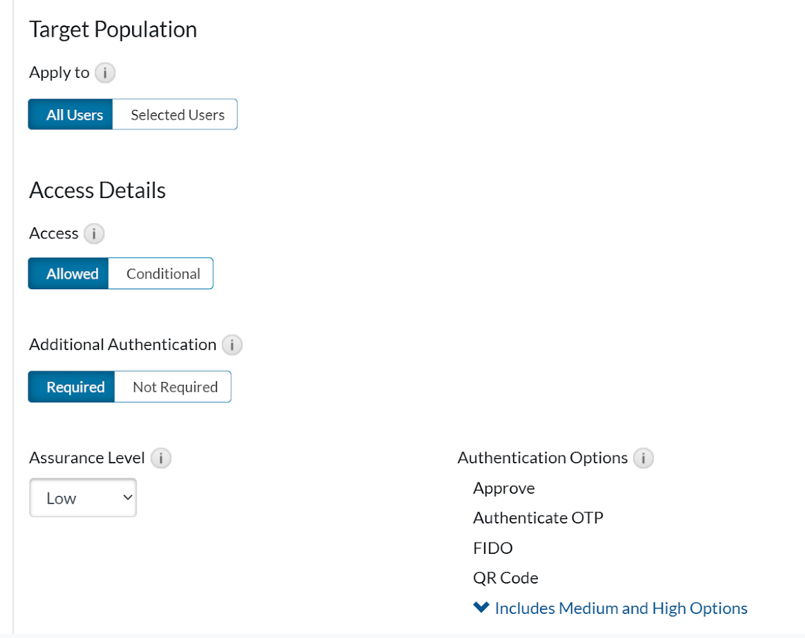
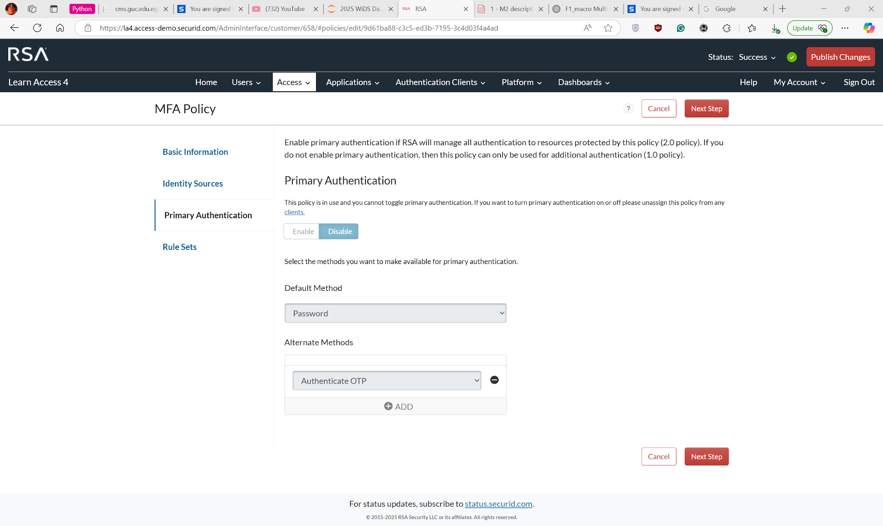
Configure MFA Policy at CAS
RSA IAM Framework

Slide 15
Configure MFA Agent - Network Settings
Virtual Machine Function (Domain Controller/MFA Agent/IDR) | MFA Agent
Operating System (Windows/Linux) | Windows
Fully Qualified Domain Name | rsa4-local.com
IP Address | 192.168.95.130
Gateway | 192.168.95.2
DNS | Primary:192.168.95.128 Secondary:8.8.8.8
RSA IAM Framework

Slide 16
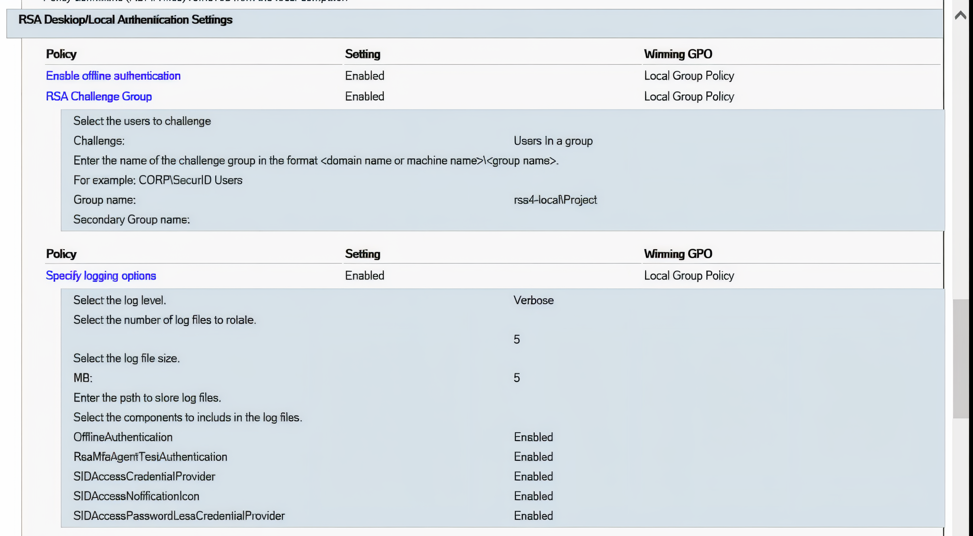
Configure MFA Agent - GPO
RSA IAM Framework

Slide 17
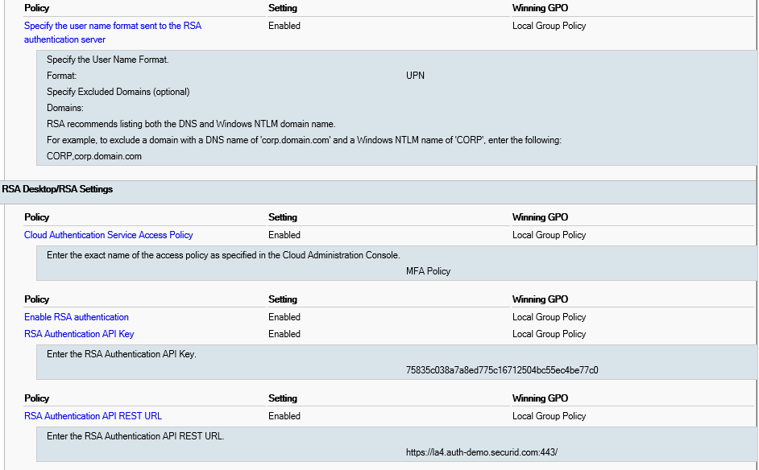
Configure MFA Agent - GPO
RSA IAM Framework

Slide 18
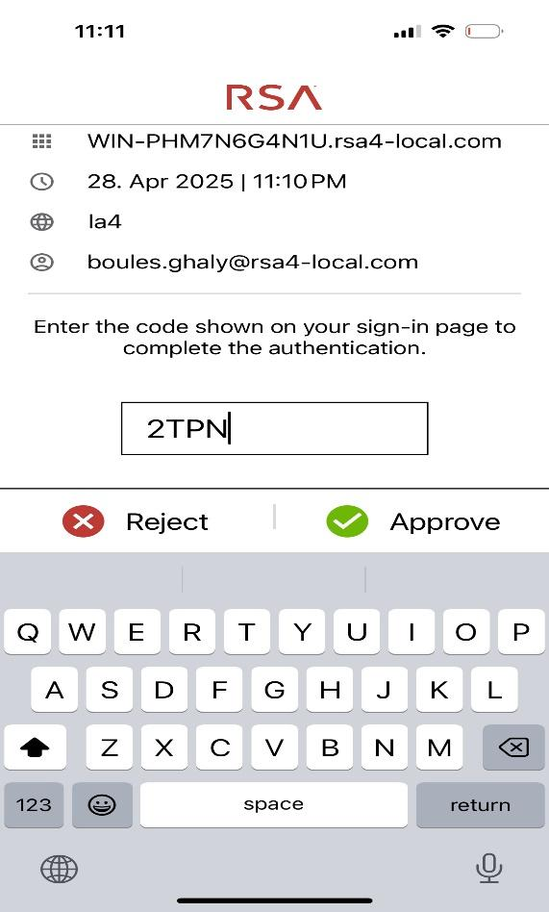
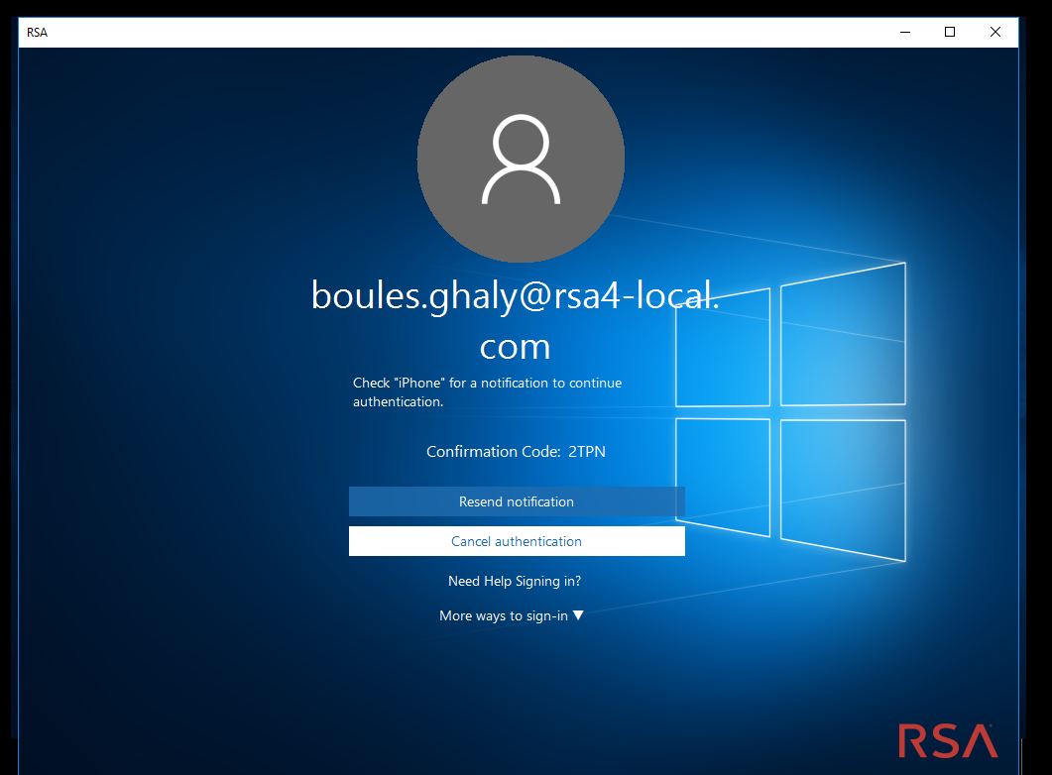
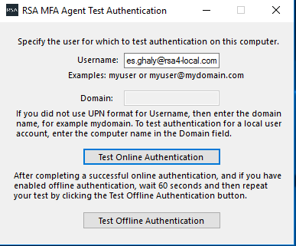
Online Test
RSA IAM Framework

Slide 19
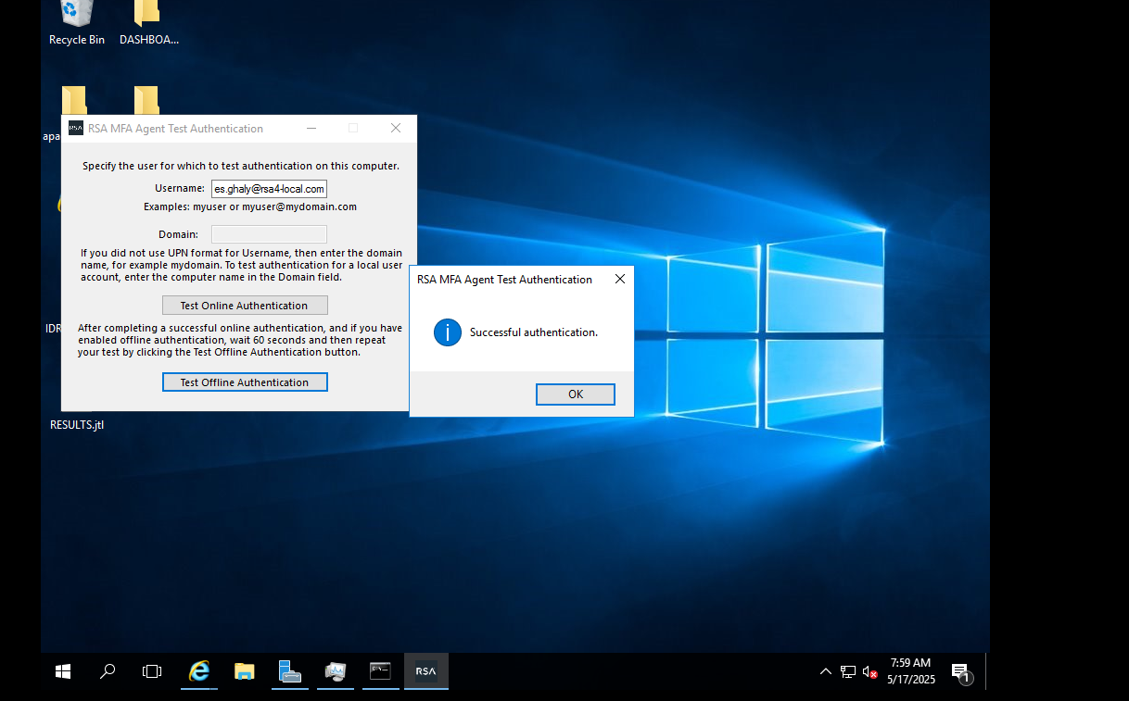
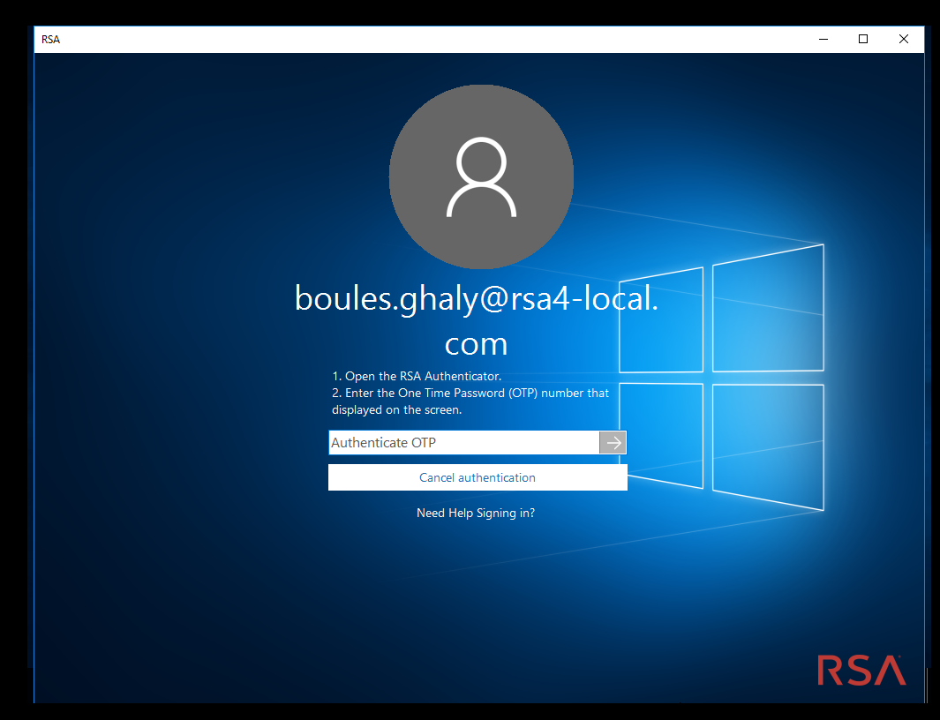
Offline Test
RSA IAM Framework

Slide 20
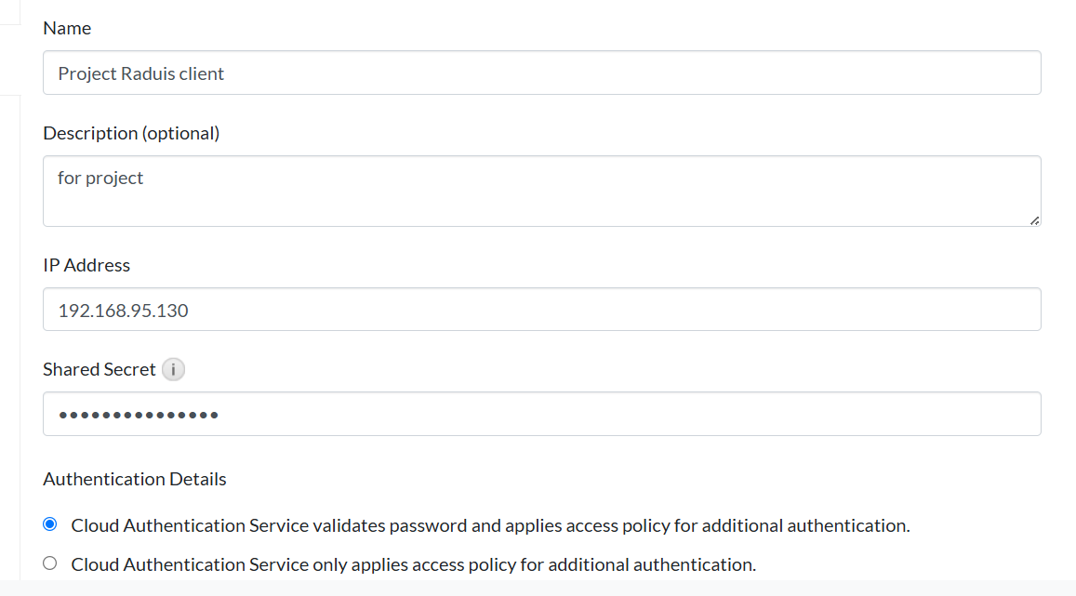
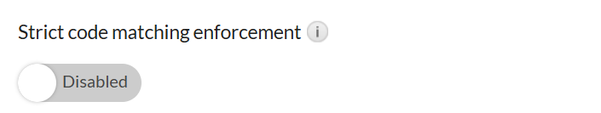
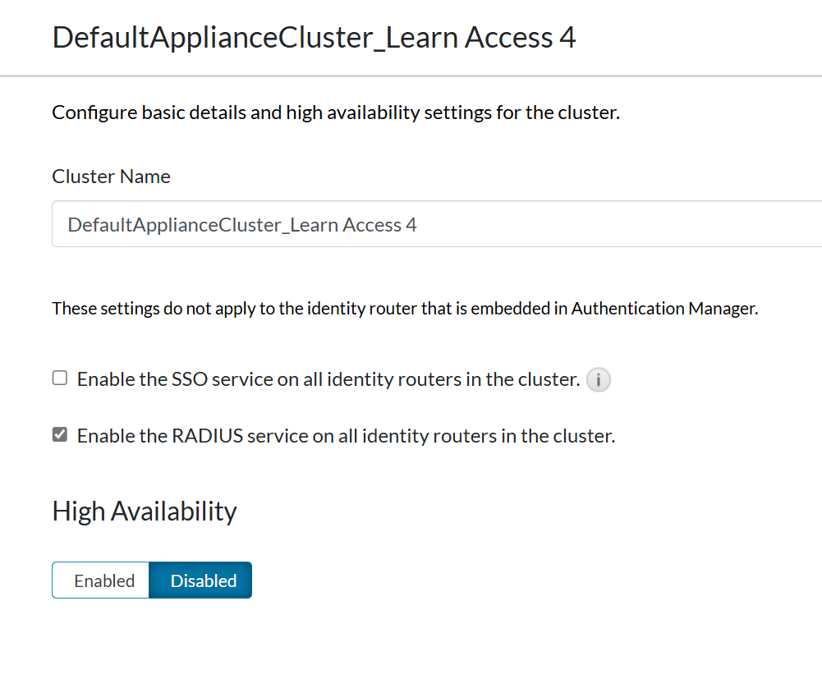
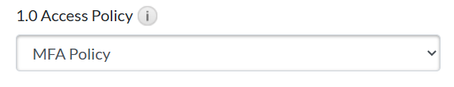
Configure RADIUS Client - on MFA Agent
RSA IAM Framework

Slide 21
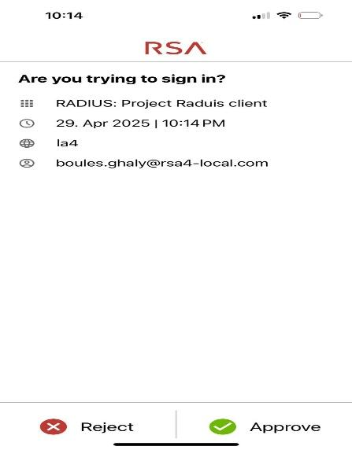
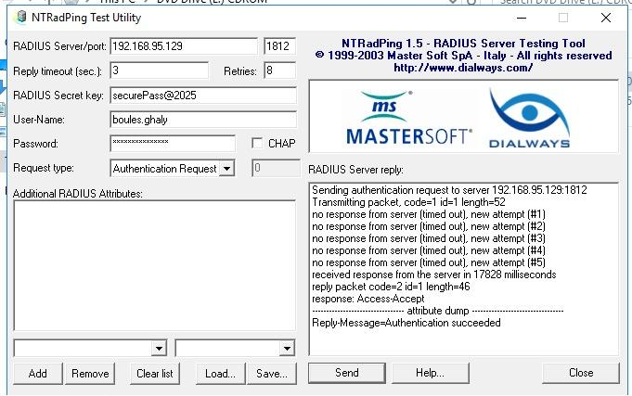
NTRADPing
RSA IAM Framework

Slide 22

3. App-Level Security
RSA IAM Framework

Slide 23
What We Did
Focused on securing the application layer using SAML-based authentication.
Integrated SAML-enabled applications with RSA Cloud Authentication Service (CAS) as the Identity Provider (IdP).
Implemented two authentication flows:
IdP-Initiated SSO: Starts when a user logs in to MyPage and launches an app from there.
SP-Initiated SSO: Starts when a user goes directly to the app, and gets redirected to the IdP (CAS) for authentication.
RSA IAM Framework

Slide 24
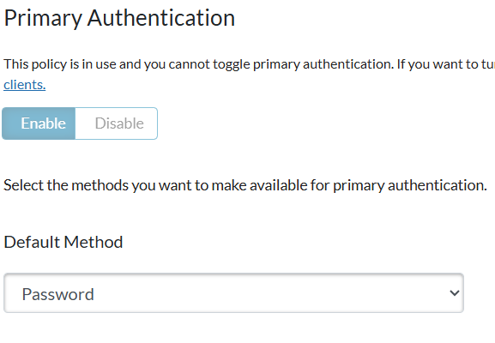
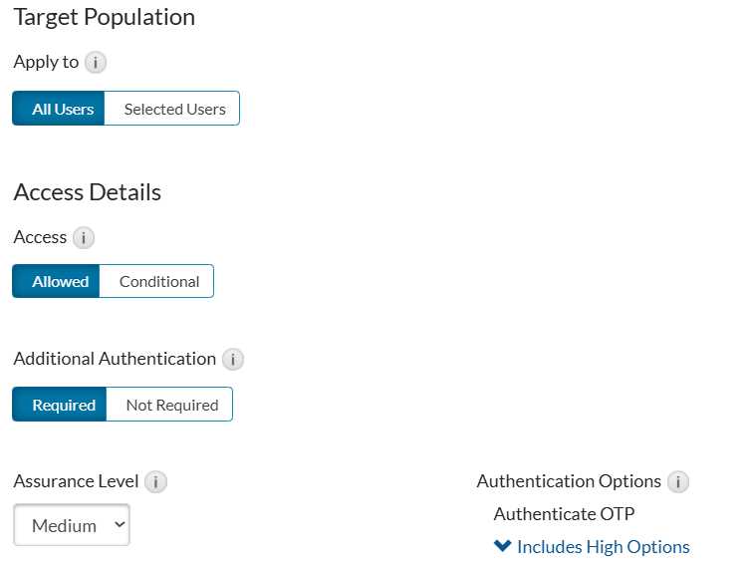
SAML Access Policy
Enforced step-up security using One-Time Passwords (OTP) using custom access policy
RSA IAM Framework

Slide 25
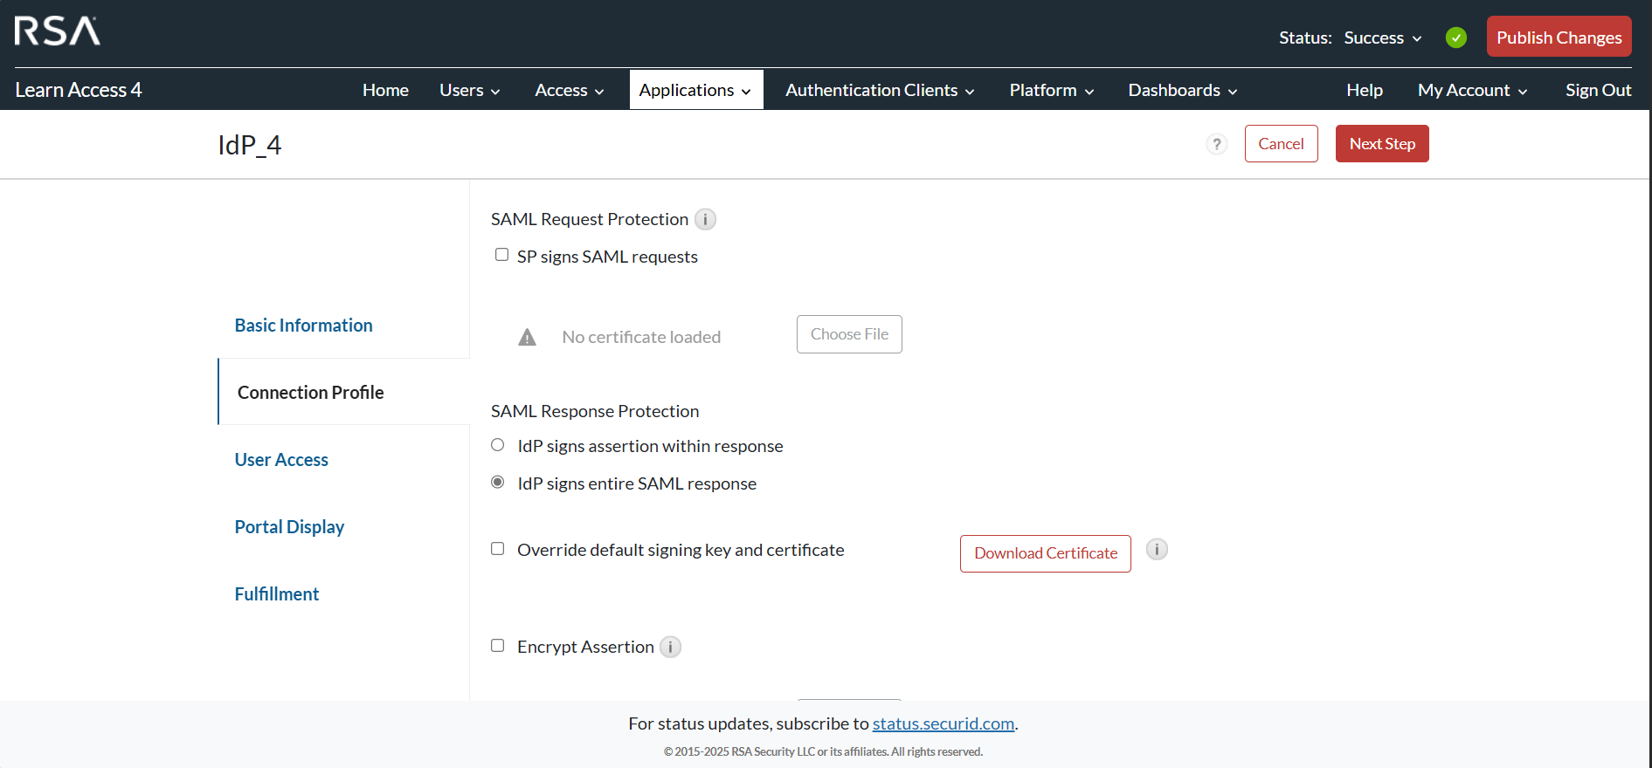
Configuration Overview
Ensured the SAML responses were signed to maintain trust.
RSA IAM Framework

Slide 26
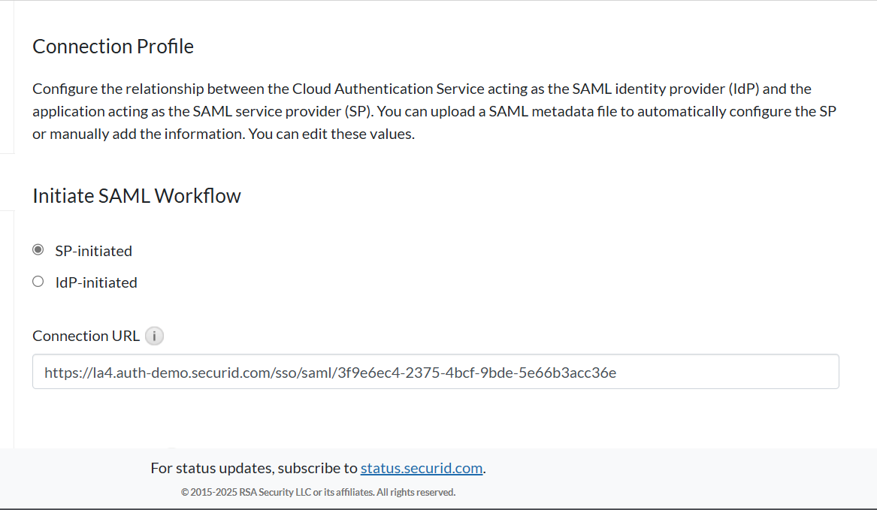
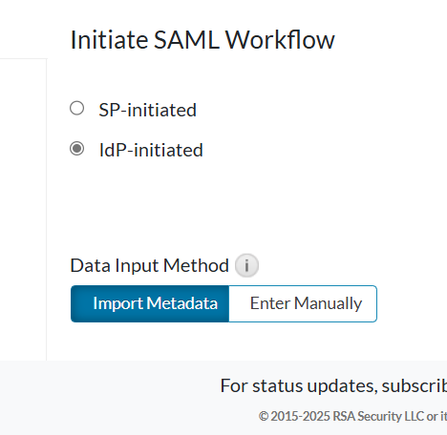
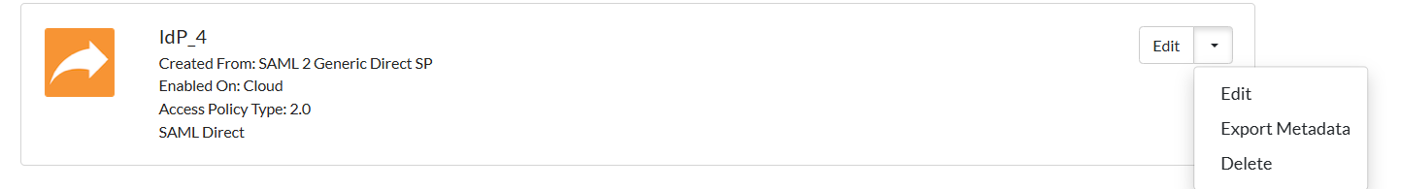
Configuration Overview
Established trust via metadata exchange
Defined whether the app flow was IdP- or SP-initiated
Set the Assertion Consumer Service (ACS) URL and SP Entity ID
RSA IAM Framework

Slide 27
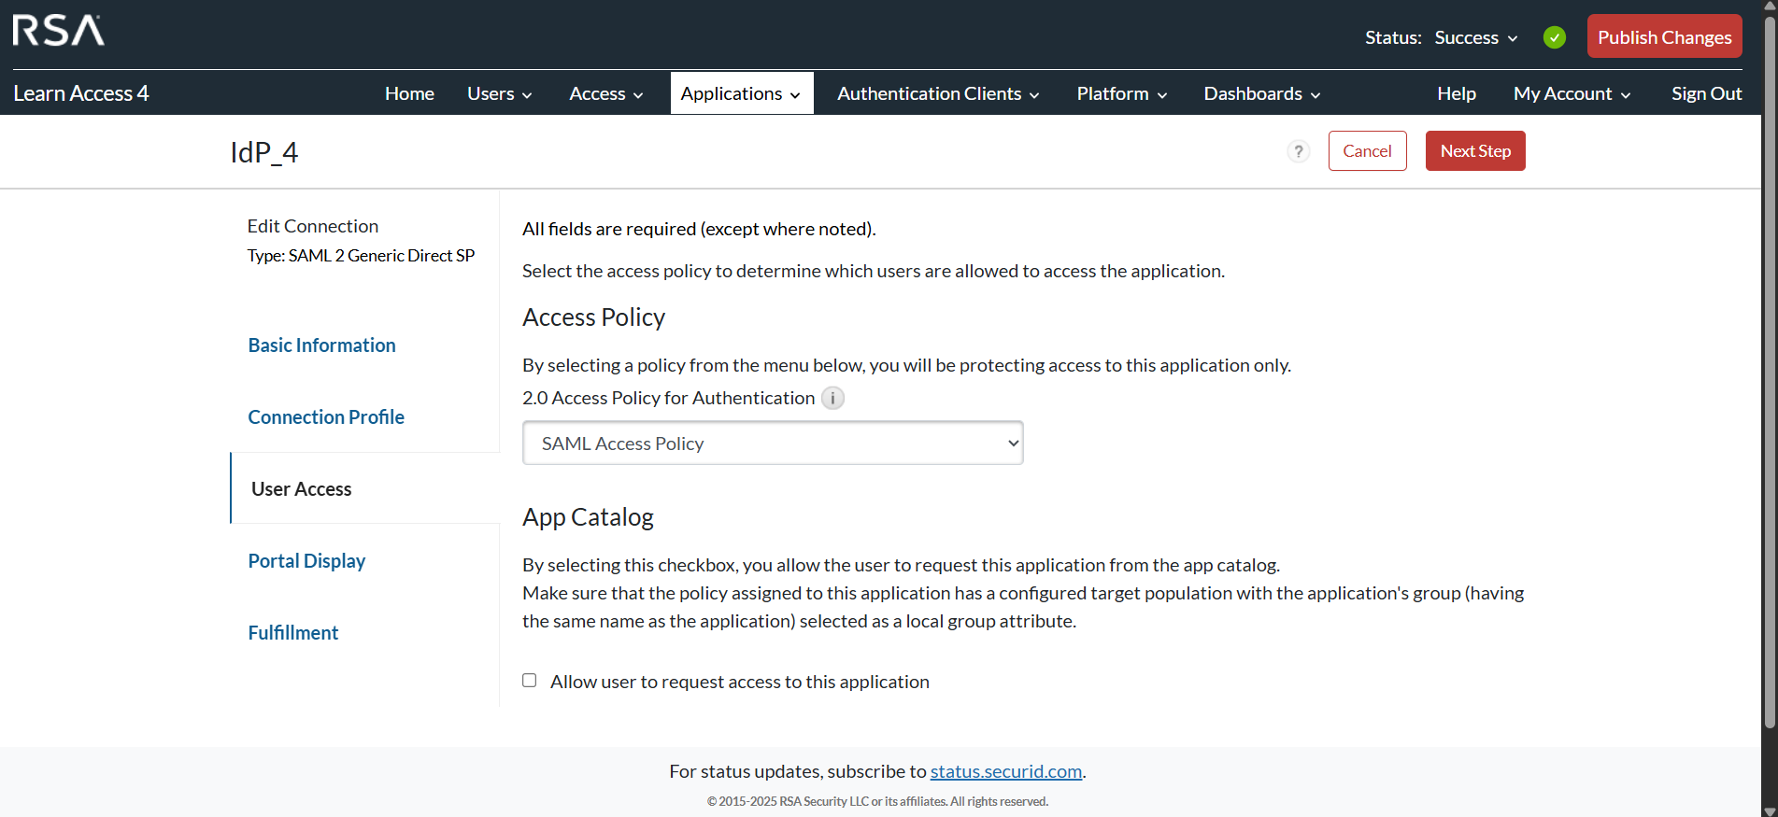
Configuration Overview
Enabled OTP policy for step-up authentication
RSA IAM Framework

Slide 28
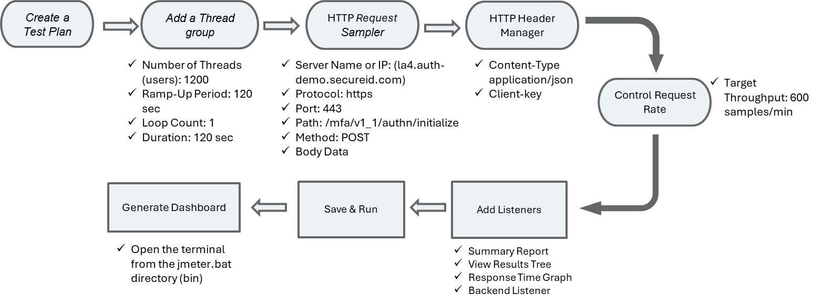
IdP-Initiated Flow
My Page
App
Auth
OTP
Success
I login to MyPage using my credentials.
I launch the protected app — immediately, I’m prompted to verify with OTP.
Once approved, I’m signed in — securely.
RSA IAM Framework

Slide 29
SP-Initiated Flow
App
CAS
Auth
OTP
Success
This time, I go directly to the app URL.
It redirects me to CAS.
I login and pass the OTP challenge.
I’m sent back to the app, now authenticated.
RSA IAM Framework

Slide 30
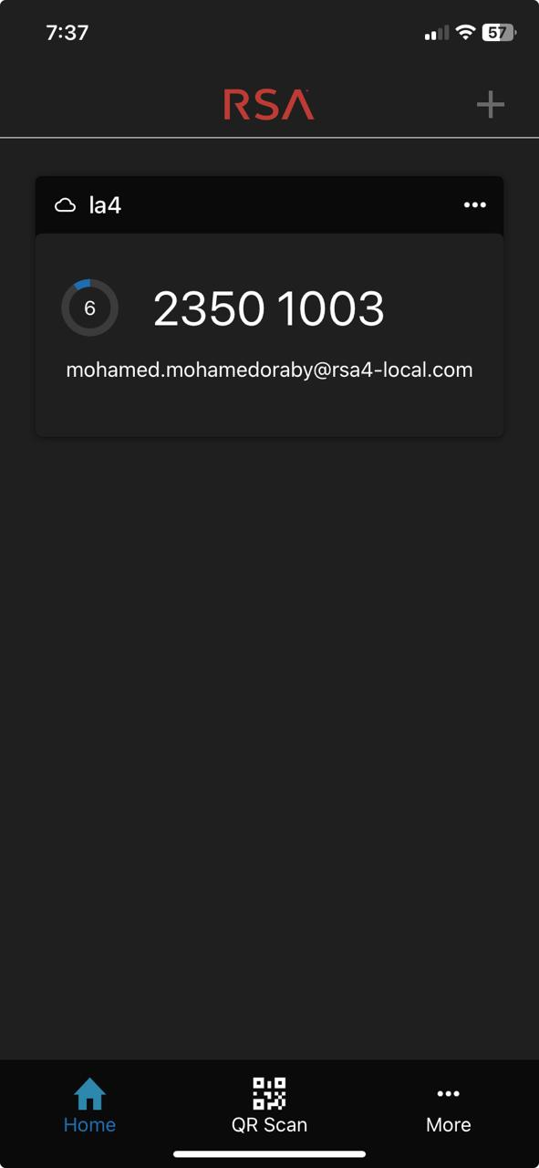
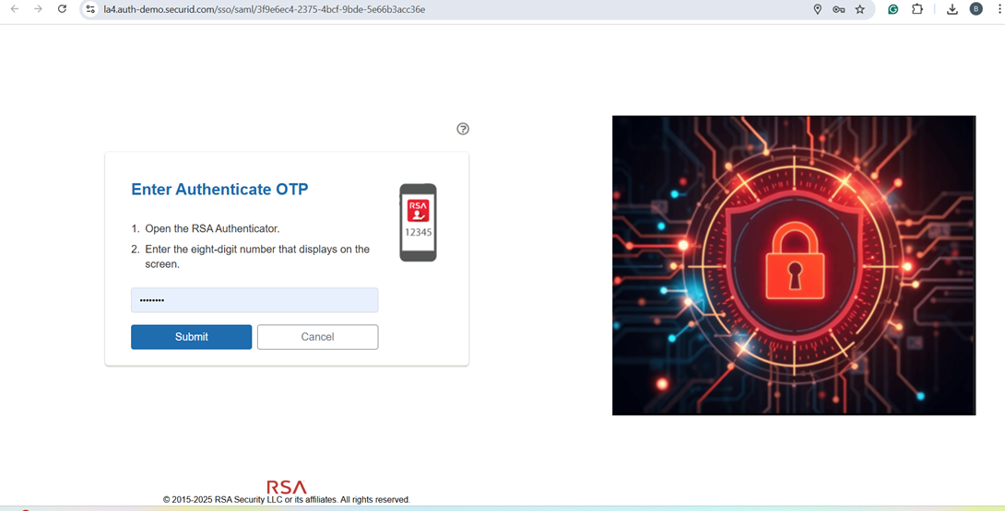
Login and test with MyPage
RSA IAM Framework

Slide 31
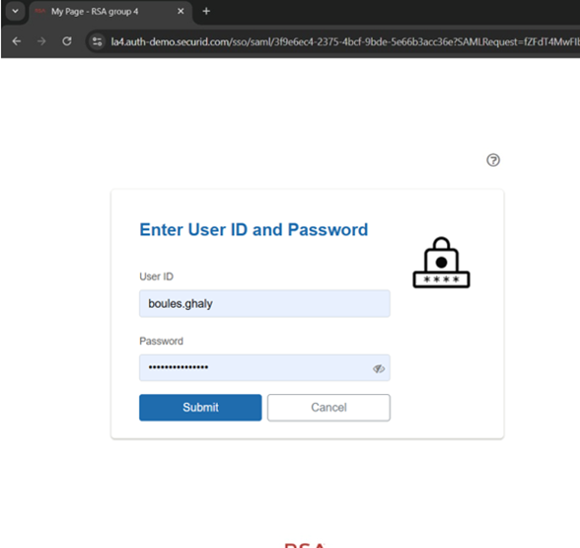
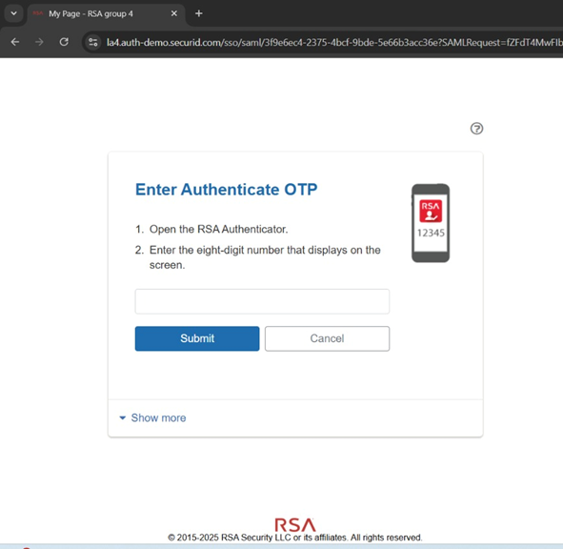
Login and test with URL
RSA IAM Framework

Slide 32
Linking Back to Previous Phases
This phase builds directly on what we’ve done before:
Our users are already synced from Active Directory
They’re protected at the endpoint level with MFA
And now, they’re securely accessing SaaS apps too.
RSA IAM Framework

Slide 33

4. Stress Testing
SecurID Solution Demo

Slide 34
CAS REST API Test
RSA IAM Framework

Slide 35
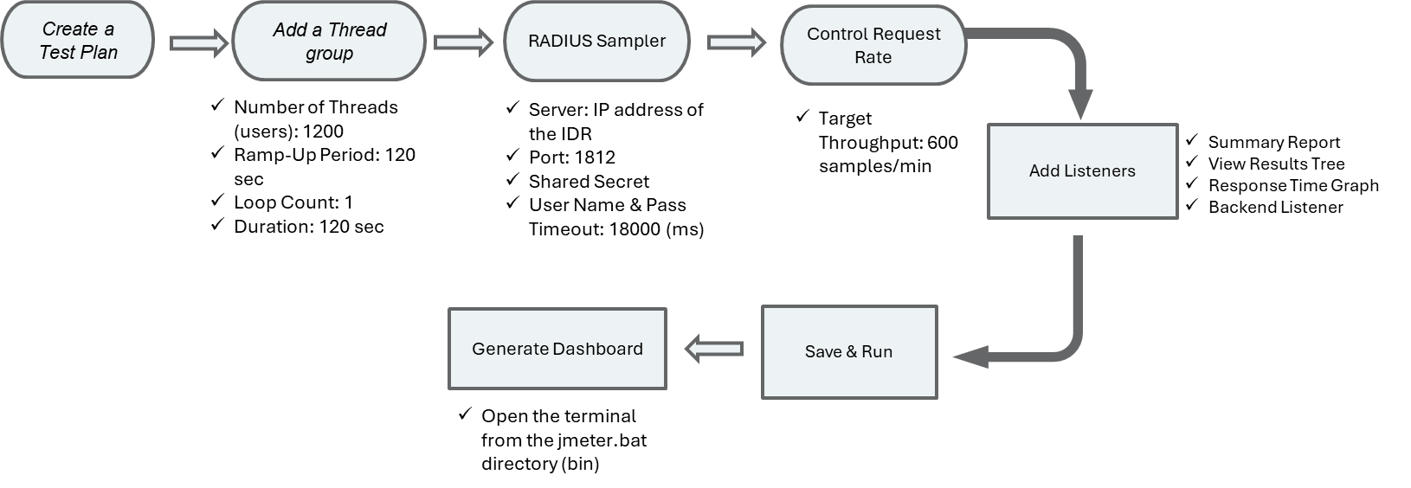
IDR RADIUS Test
RSA IAM Framework

Slide 36
Conclusion & Recommendations
RSA IAM Framework

Slide 37
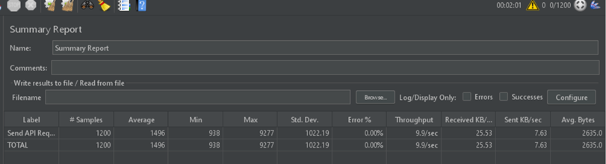
CAS Rest Api Test Results
As shown here the test was successfully completed with the required number of requests (10req./sec for 2mins).
There were no error and the average response time was 1.5 sec
RSA IAM Framework

Slide 38
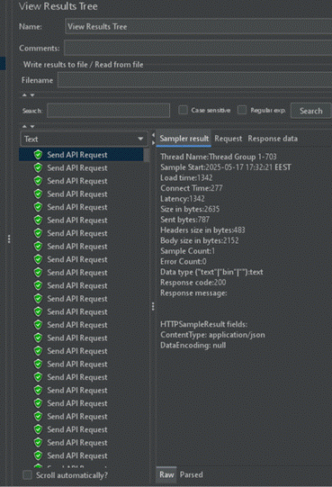
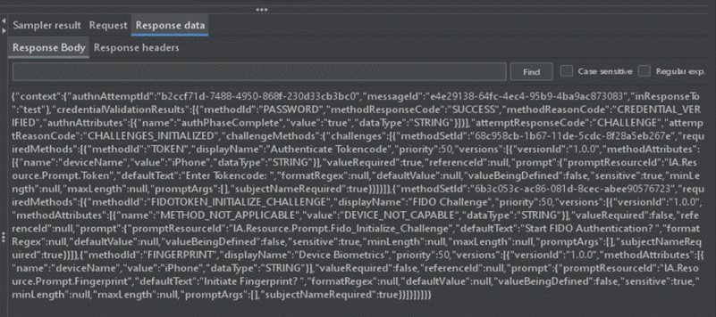
CAS Rest Api Test Results
Every request was a success with Credentials verified but waiting on Challenge completion.
(This is due to the Access policy requiring step up authentication)
RSA IAM Framework

Slide 39
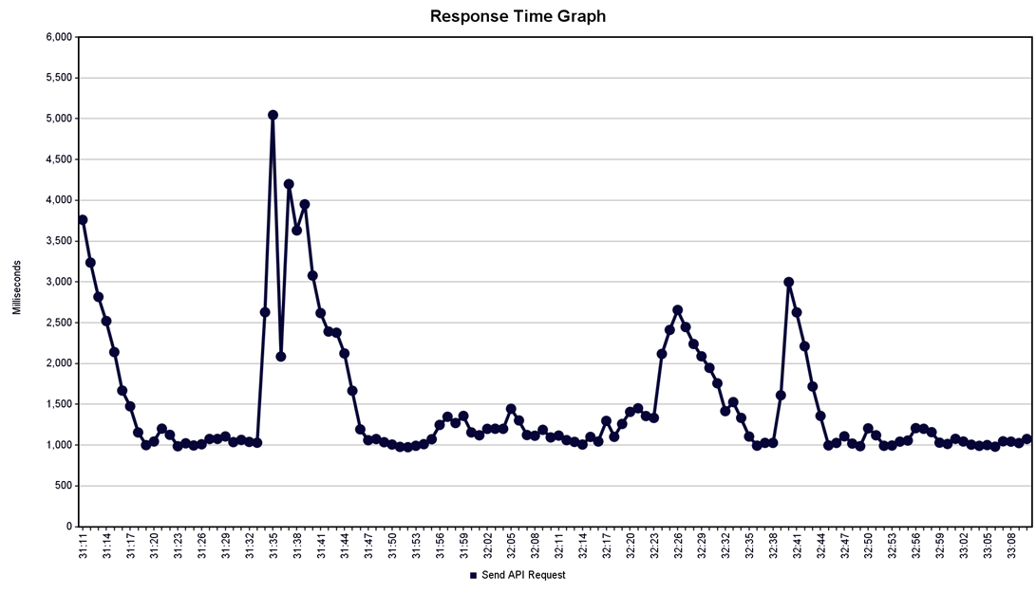
CAS Rest Api Test Results
Key Observations:
1. Two Mid-Test Spikes (~5,000 ms and ~3,000ms)
· This suggests the server might have been overloaded, or suffered from bottleneck (e.g., CPU/DB bottleneck).
2. Rapid Recovery
· Indicates that the system recovered after congestion.
3. Stabilization at ~1,000 ms
RSA IAM Framework

Slide 40
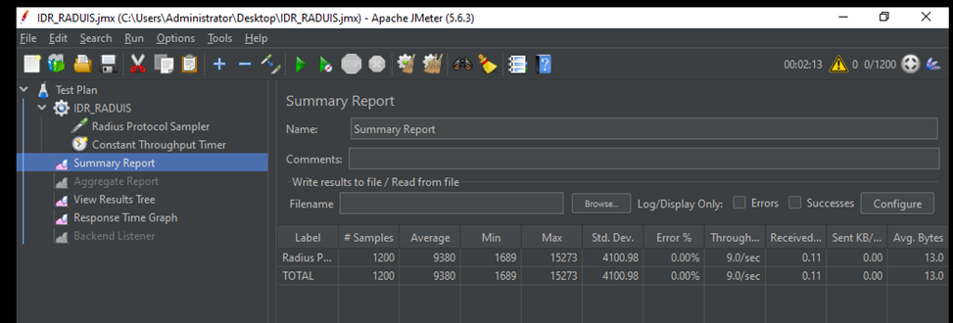
IDR RADIUS Test Results
As shown here the test was successfully completed with the required number of requests (10 req./sec for 2 mins)
There were no error and the average response time was 9.3 sec which was much higher than that of CAS (1.5 sec)
RSA IAM Framework

Slide 41
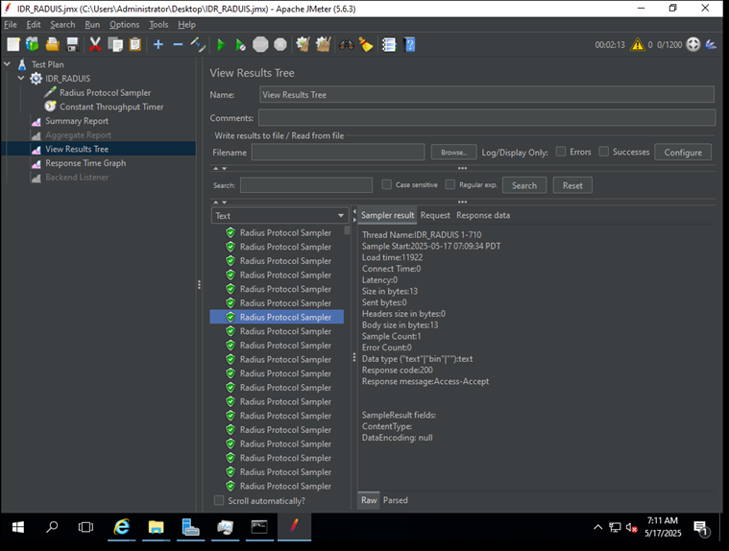
IDR RADIUS Test Results
Every request was a success with a response msg of Access-Accept. (This is due to changing the Access policy to allow users to authenticate without step up authentication)
RSA IAM Framework

Slide 42
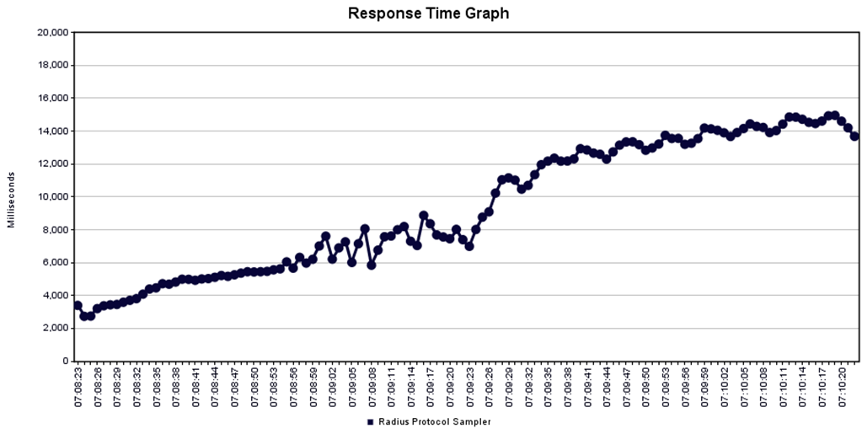
IDR RADIUS Test Results
Key Observations:
1. Steady Increase in Response Time
· However the system is functionally resilient, though not optimal.
2. Possible Bottlenecks or Resource limitation:
· The upward trend suggests that either the IDR is becoming overloaded, or there is a resource limitation (CPU, memory, or other VM capabilities)
3. Performance Degradation:
· The performance does not stabilize over time. This could lead to timeouts or failed authentications in larger number of requests.
RSA IAM Framework

Slide 43
Recommendations
Investigate resource utilization on the IDR during both types of testing (CPU/memory/thread stats) this can be done by varying the requests/sec .
Tune testing configurations that could better simulate the required requests/sec.
Hosting the IDR on cloud-based server, could produce better results achieving less response times.
RSA IAM Framework

Slide 44

RSA IAM Framework

Slide 45
Thank You
Any Question !
RSA - GROUP 4
RSA IAM Framework

Slide 46
EXTRA SLIDES FOR QUESTIONS
RSA IAM Framework

Slide 47
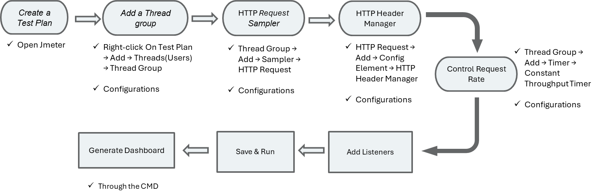
CAS REST API Test
RSA IAM Framework

Slide 48
CAS REST API Test
RSA IAM Framework

Slide 49
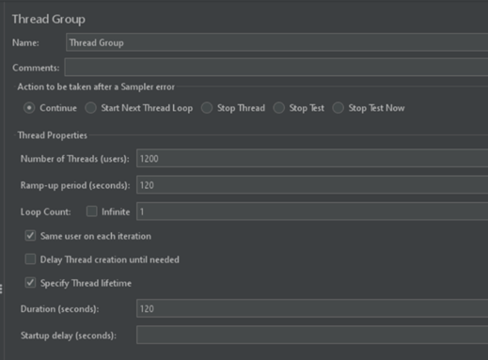
Thread Group Configuration
Number of Threads (users): 1200
Ramp-Up Period: 120 sec
Loop Count: 1
Duration: 120 sec
RSA IAM Framework

Slide 50
CAS REST API Test
RSA IAM Framework

Slide 51
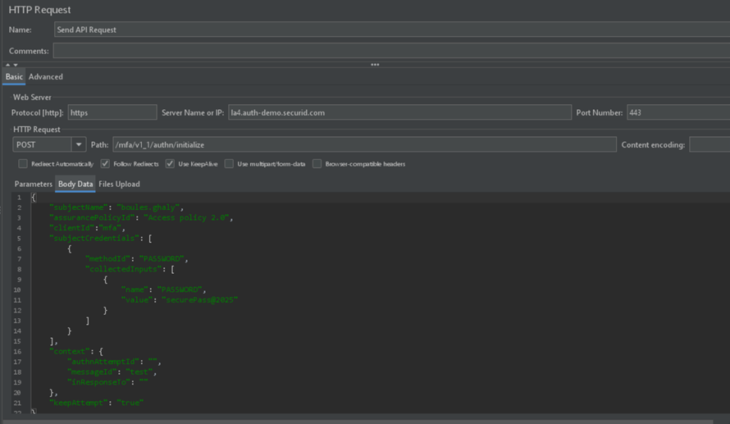

Sampler Configuration
Server Name or IP: (la4.auth-demo.secureid.com)
Protocol: https
Path: /mfa/v1_1/authn/initialize
Method: POST
RSA IAM Framework

Slide 52
Sampler Configuration
Username & Password
Policy ID
RSA IAM Framework

Slide 53
CAS REST API Test
RSA IAM Framework

Slide 54

HTTP Header Manager Configuration
RSA IAM Framework

Slide 55
CAS REST API Test
RSA IAM Framework

Slide 56

Constant Throughput Configuration
600 samples/minute means 10 requests per second (600 ÷ 60 = 10).
RSA IAM Framework

Slide 57
CAS REST API Test
Listeners
Generate the Dashboard
• Summary Report
• View Results Tree
• Response Time Graph
• Backend Listener (for dashboard) only active when run from CMD
jmeter.bat -n -t ..\..\CAS_TEST.jmx -l ..\..\results.jtl -e -o ..\..\dashboard
RSA IAM Framework

Slide 58

IDR RADIUS Test
RSA IAM Framework

Slide 59
IDR RADIUS Test
RSA IAM Framework

Slide 60

Sampler Configuration
RSA IAM Framework

Slide 61
Comparison
Feature | SP-Initiated Authentication | IdP-Initiated Authentication
Initiating Party | Service Provider (SP) | Identity Provider (IdP)
Authn. Flow | 1. User accesses SP through the link provided, this initiates SAML AuthnRequest to the IdP. 2. SP send AuthnRequest to the IdP and redirects user to the Idp 3. IdP authenticates user using username and password. 4. User is then prompted to enter an OTP from the authenticator app. 5. If both credentials and MFA succeed, the IdP generates a SAML Response and sends it to the SP. 6. SP verifies the SAML Response and grants access | 1. User accesses IdP portal (mypage) 2. IdP (mypage) authenticates user using primary auth (user + password) then a step up authentication (push notification and approve on mobile phone) 3. user clicks on the application 3. IdP sends SAML response to SP 4. SP requires another MFA (Authentication OTP from the app on the phone) 5. SP grants access
RSA IAM Framework

Slide 62
Feature | SP-Initiated Authentication | IdP-Initiated Authentication
User Experience | Starts from the RSA Demo app (typing the url of the app in the portal taken from the IdP metadata ) | Starts from my page
SAML Request | Sent by SP to IdP | Not required (unsolicited SAML response from IdP)
SAML Response | Returned from IdP to SP after authentication | Directly generated by IdP after login
Use Case Suitability | Best when users directly access apps | Best for SSO portals like mypage
RSA IAM Framework

